Slide 1




Wine Reviews & Rating Analysis
By: Ben Lew, Flora Choi, Janine Yoro, Patrick Po, Ahsan Tebha
Notes:
This is our intro card

Slide 2

AGENDA
PURPOSE
PREPROCESSING
ANALYSIS/MACHINE LEARNING
TECHNOLOGY OVERVIEW
DASHBOARD/RESULTS
CONCLUSION
Q&A
Notes:
Agenda

Slide 3
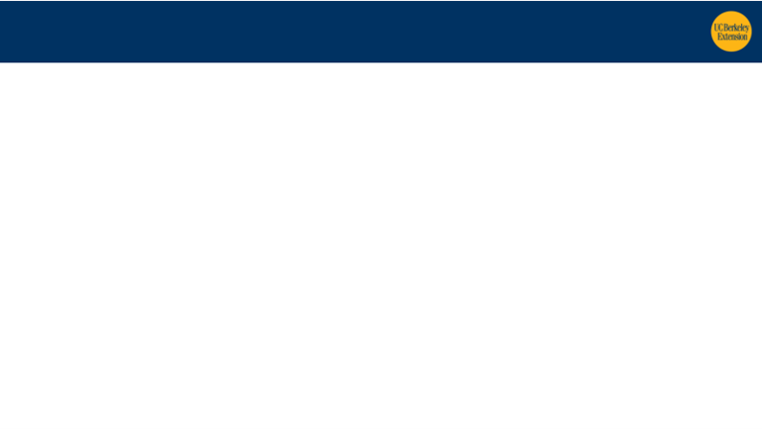
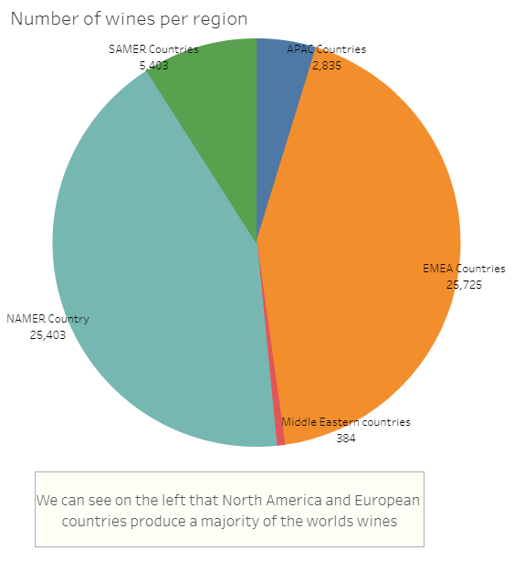
After a long day, we all unwind in some way…
We choose the topic of wine
Reason being many people like drinking, especially during a global pandemic
Notes:
Topic and reason lead in.

Slide 4
Drunk and Giving Directions
Our source data originated from winemag.com through a web scrape that an avid wine enthusiast scraped up.
The question we hoped to answer was “Is rating predictive of future pricing?”
Challenges experienced with this question were the following:
We couldn’t make a unique identifier.
We couldn’t map the wines year to year.
Too much drift in the 2018 data set.
Ultimately 2017 had enough data points to run through the model.
This made the ASK evolve to:
“Is rating predictive of price for the year?”
Notes:
Description of source data and question to be answered. Graphic related to question,pre processing (Ahsan)

Slide 5
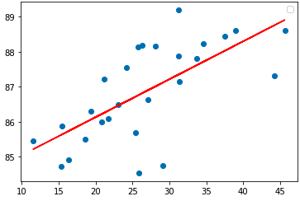
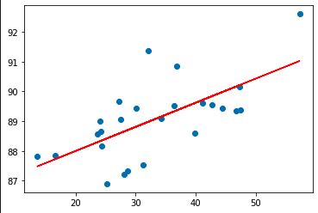
Better Preparation Leads to Better Execution
What we did:
Downloaded 2017 Dataset (150k Rows)
Scraped WineMag 2018 Dataset (22k Rows)
Dropped columns not relevant to analysis
Dropped NaN values
Created Target Columns
2017
2018
Notes:
For our data pre-processing, we validated our ask by using linear regression. We started with 150.000 data rows for the 2017, and scraped around 22k rows for 2018.

Slide 6

Data Exploration & Analysis
Our methodology for feature engineering was to first get a high level view, address the nulls, outliers and then organize/prepare the data.
Analysis Overview
59,790 rows
Few modifications applied to dataframe
Change columns names for readability
Change numerical data types to integers
Removed all the commas in the wine_type column to avoid creating additional columns in the csv
Notes:
Table creation by Janine and machine learning intro
So to reiterate what Patrick said, we cleaned up the data and
While the original requirement asked for only 1,000 rows
we ended up with 59,790 rows after preprocessing.
We then apply a few modifications to the dataframe to get us in gear for data exploration.
Those modifications include : (see points)
So let’s take a closer look at that dataframe. next slide.

Slide 7
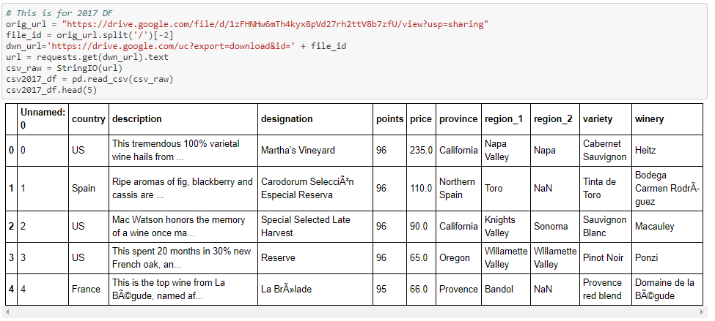
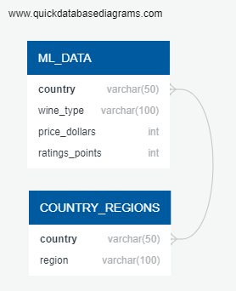
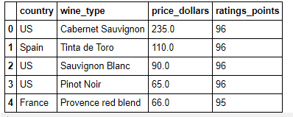
Preprocessing: Dataframes/Tables
1
DATABASE
CSV FILE
2
CONTINUES FOR PROCESSING FOR MACHINE LEARNING
Notes:
Here you can see the original dataframe and how it looked after the clean-up.
Dataframe has one of two paths:
It becomes a CSV file to be pushed into (1) Our Database
This is a diagram of what we anticipate our tables to look like for the database
Here’s our dataframe
And an additional table showing countries by region
(2) It continues on for processing for our machine learning model

Slide 8
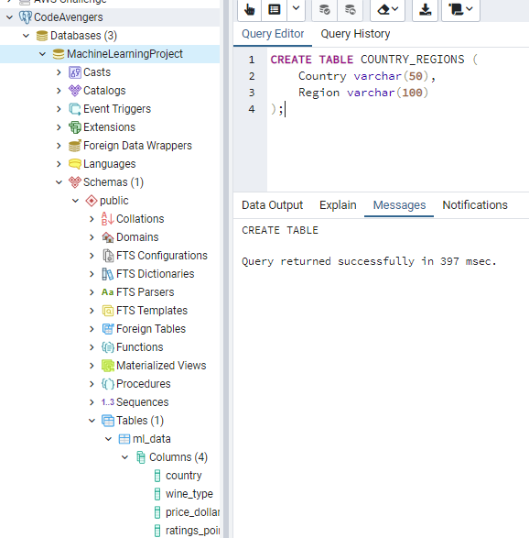
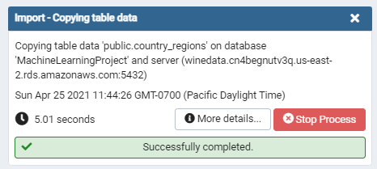
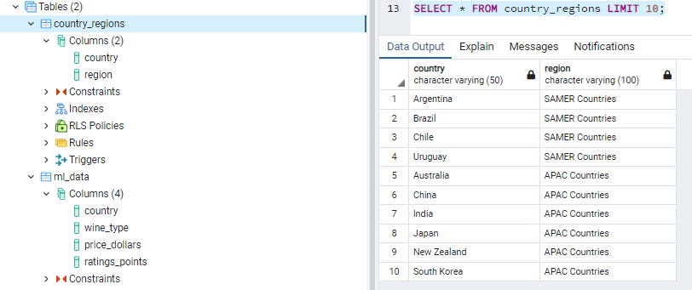
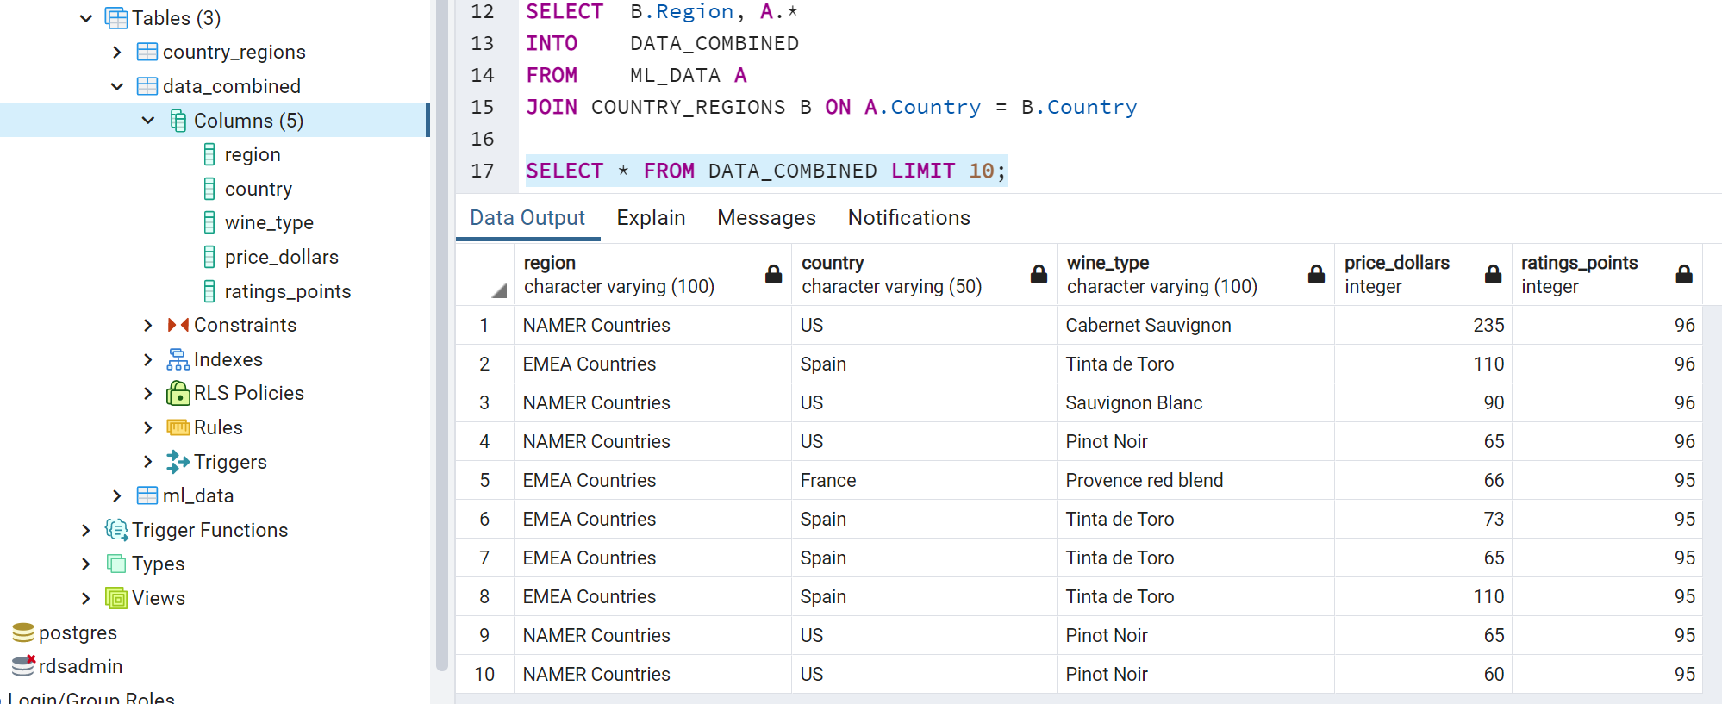
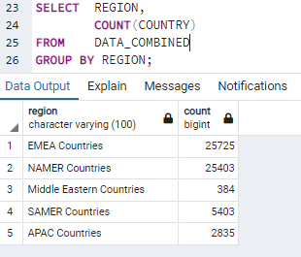
Database
2
● Establish a connection between AWS RDS and PostgreSQL
● Establish a connection between our notebook code to both AWS RDS & PostgreSQL
● Bring in the COUNTRY_REGIONS dataset for the purpose of joining and future reporting.
1
3
4
Ex
Notes:
So first, let me talk about the database:
In Postgres is where we created the CodeAvengers server. (click animation) This is where we linked the connection & assigned AWS as the Host Name / Address – which is the endpoint provided by RDS
Next, the MachineLearningProject is our database that will contain all of our tables –
Touching back to the life of our CSV file and our Colab notebook, there is where we establish a connection between our code and both AWS & Postgres
In the notebook, that is also where we create our table schema based on the ERD shown prior
And then we push that csv file to our table - here in the first frame, you can see that the ml_data table has already been imported in (click animation)
Next if you recall the second table in our ERD, we brought in this dataset to categorize all of our countries into 5 main regions,
One, for the purpose of joining and two, future reporting.
So, this is a step-through of that process:
we created the schema of what our imported table would look like
Imported the csv
Query the data and check the table
Then we joined the two tables together using country and this is a quick snapshot of what the DATA_COMBINED table looks like
Here is an example of a simple query you can run using the combined table: it’s showing how many countries fall under our self-defined regions.
My suggestion, keep these in mind as you’ll see more stats regarding these regions later on in our dashboard.

Slide 9
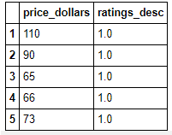
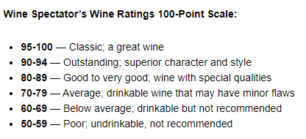
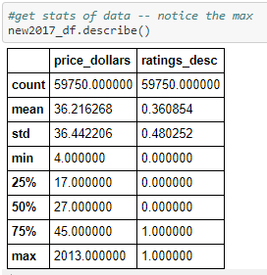
Machine Learning - Initial Model
MAIN OBJECTIVE: GET A MODEL TO WORK Begin by building a working model at its simplest form. Eliminate any noise related to descriptive columns & keep only the numerical values.
DISTRIBUTION
Check the spread of price
Normal distribution?
Address Outliers (Remove top 1%)
Create a new categorical value
GOOD WINE: Ratings 89 or Below GREAT WINE: Ratings 90 or Above
74%
LOGISTIC REGRESSION MODEL
FEATURES VS TARGET
Feature: PRICE_DOLLARS Target: RATINGS_DESC (“0” For Good Wine, “1” For Great Wine”)
FINAL DATAFRAME
Split the data into Training and Testing
Created the Logistic Regression Model
Fit / Trained the model
Made Predictions
Validated model using confusion matrix
Generated an accuracy score
Source: http://www.winewins.com/wine-ratings/
Notes:
Now jumping into the second path of our dataframe - the Machine Learning model.
At this point, our main objective was to just get a model to work.
Our first thought was to build a model at its simplest form.
This meant eliminating any noise related to descriptive columns and keeping just the numerical values.
Which lead to further preprocessing of the dataframe.
First we created a new categorical value.
Against this Rating Point Scale, our rating points ranged between 80 and 100. So we decided to bucket our ratings as Good Wine or Great Wine.
Next, we wanted to establish our features and our target.
Our feature was price in dollars
Our target, after a little bit more preprocessing was assigned a “0” for good_wine and “1” for great_wine.
And what we ultimately did was create a new column called ratings description to reflect our model’s target.
This is an example of what that dataframe looks like.
Next, with this new dataframe, we wanted to understand the spread of our prices and normalize it by addressing our outliers.
We decided to remove the top 1% of our dataset.
Once everything was cleaned up, our final dataframe was ready for the Logistic Regression Model.
Once we got 74%, it prompted the team to more questions and propelled us forward into further analytics and new renditions of the model.
Here to talk about some of those models is Flora.

Slide 10
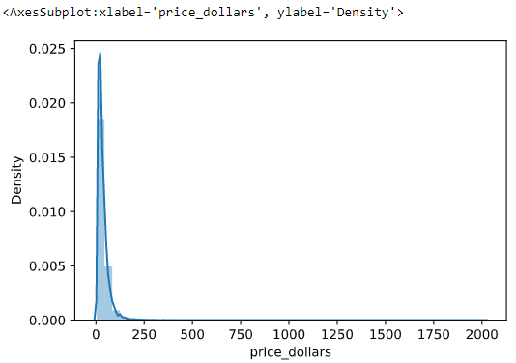
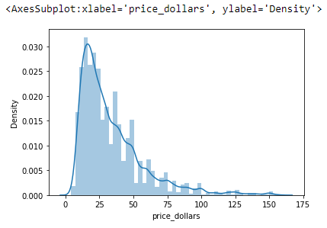
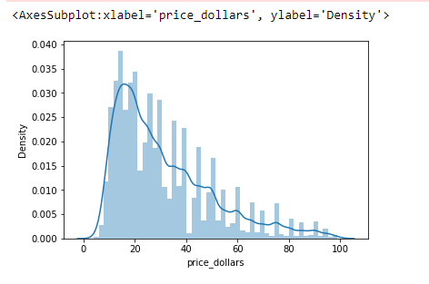
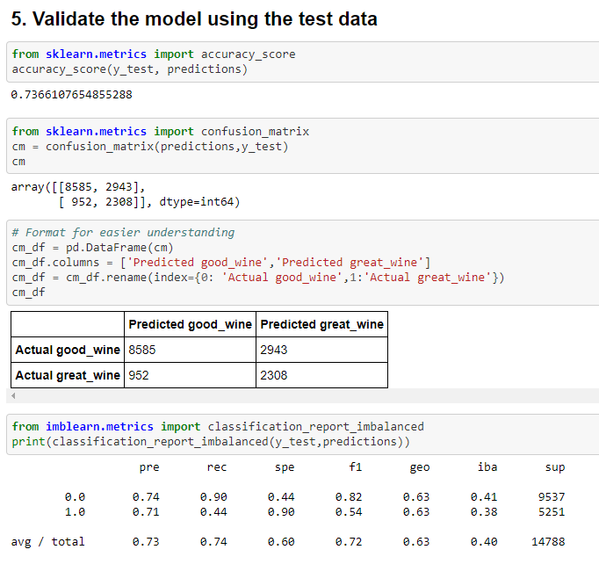
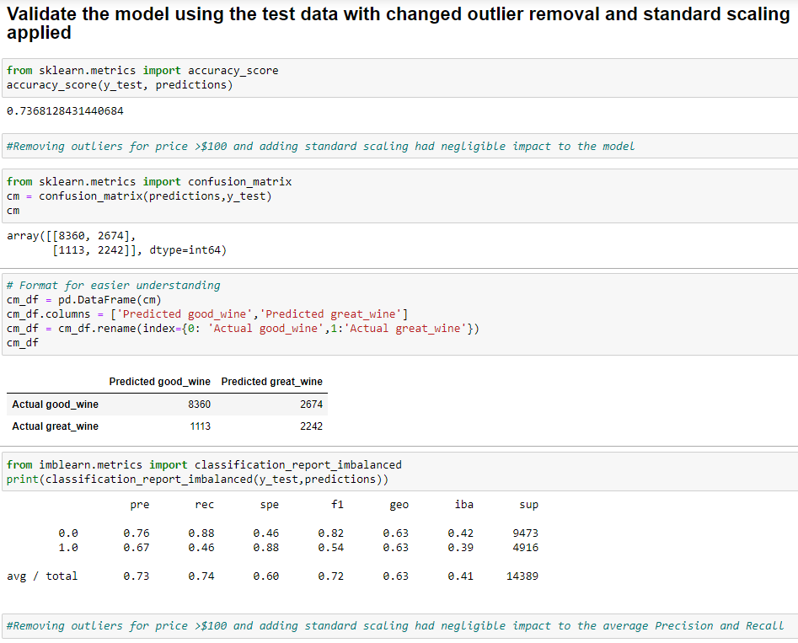
Machine Learning - Model Optimization
Outliers re-defined to >$100 price
Standard Scalar applied
Full Dataset Distribution
Notes:
Machine learning model optimization efforts with outlier re-definition and standard scalar described, but negligible impact - Flora

Slide 11
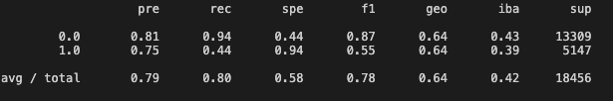
Machine Learning - Validation Models
 | US | Other Countries
Accuracy Score | 73% | 80%
Confusion Matrix
 | Predicted Good Wine | Predicted Great Wine
Actual Good Wine | 9,433 | 3,193
Actual Great Wine | 921 | 1,907
 | Predicted Good Wine | Predicted Great Wine
Actual Good Wine | 12,558 | 2,907
Actual Great Wine | 751 | 2,240
Classification Reports
Notes:
Additional Machine learning effort with same dataset but separating US from Rest of World. US accuracy similar to original model but Rest of World achieved higher accuracy score - Patrick

Slide 12
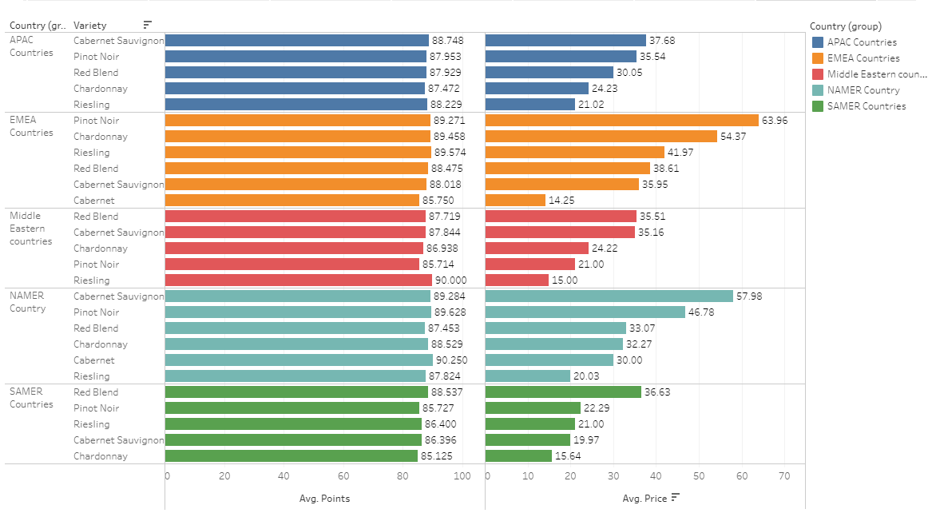
Tech Used & Results
Technology Overview:
Python, Tableau, Postgres
Google Colab, Github
Dashboard:
Link to our Tableau project: Link to Tableau
Notes:
In this slide, I will be reiterating the technology we used, which were Python and Postgres to create and clean our data/data frame, then used Tableau to display our data in a pretty format. We utilized Google colab and github for collaboration notes.

Slide 13
Conclusion, Further Analysis, Alternative Actions
Ask: Is rating predictive of price? Yes it is.
The data set could be further drilled down…
Run multiple regression models both linear and logistic to find best correlating features

Slide 14
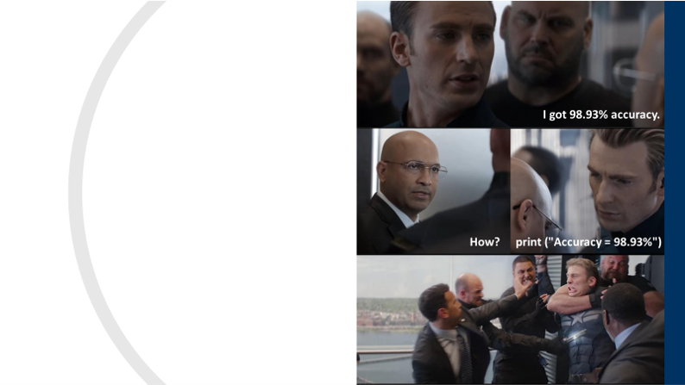






Thank You
Powered By:

Slide 15

Q&As
Notes:
Prepare for questions.

Slide 16


Slide 17

WINE

